Slide 1
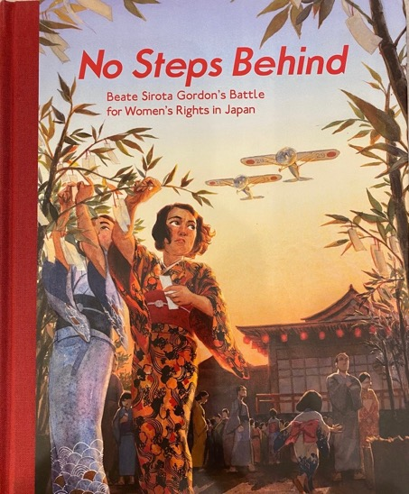
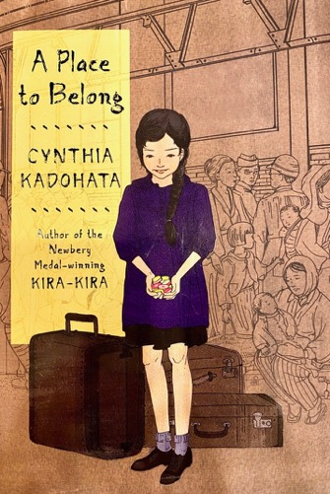
Welcome to Asian American Books to Use in the Classroom
Mary Roberts
East Asia Resource Center
UW
NCTA
No Steps Behind by Jeff Gottesfeld
2020 Freeman Award for Children’s Lit.
A Place to Belong by Cynthia Kadohata
2019 Freeman Award for Middle School

Slide 2
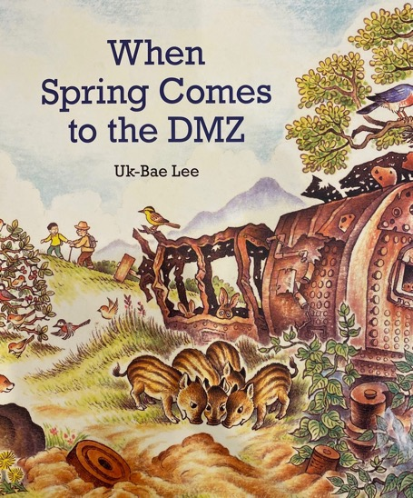
Freeman Awards for East and SE Asia: Children’s Lit, Middle and High School
“Cultural authenticity is not just accuracy or the avoidance of stereotype, but involves cultural values, facts, and attitudes that members of the culture as a whole consider worthy of acceptance and belief”
Weimen Mo and Wenju Shen
When Spring Comes to the DMZ by Uk-Bae Lee
2019 Freeman Award for Children’s Lit. (Of Note)

Slide 3
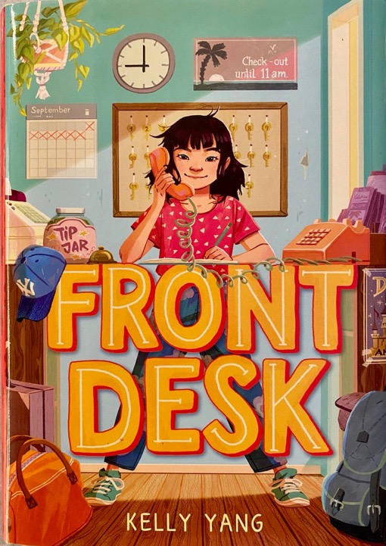
How to Choose?
Cultural Authenticity
Authority,
Power, and Voice
Agency
:

Slide 4
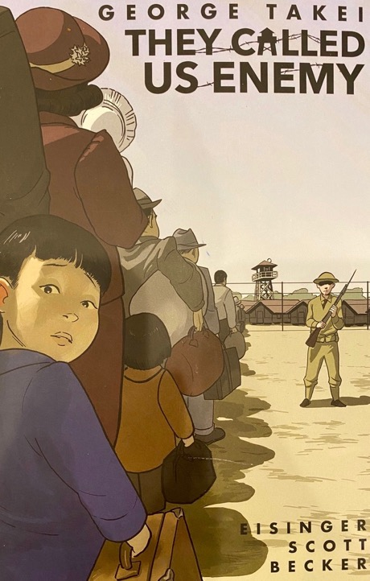
Ways to Encourage Student Reflection
Analysis of visual images in picture books and graphic novels
Choice
Open ended writing prompts
Notes:
Graphic Literature
1. What are the main events and how are they sequenced? You may choose to use a story map.
2. Choose one character. What is conveyed through the art, and what is conveyed through the text?
3. As an interaction of image and text
From the Image
What do you know about the place, time, and situation?
How does the art focus your attention?
How do the images reflect power and authority
From the Text
What do you know about the place, time, and situation?
How does the text reflect power and authority, agency and voice?

Slide 5
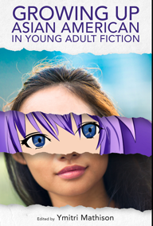
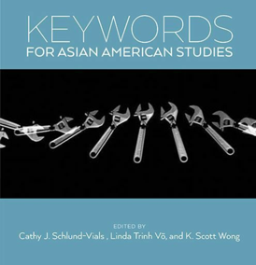
Further Study
Read and interrogate each text.
Explore the National Consortium for Teaching About Asia (NCTA) website to watch for workshops on Asian Americans, book clubs and classes about the Freeman Award Books.
East Asia Resource Center UW https://jsis.washington.edu/earc/
Investigate the Council On Interracial Books for Children.
Notes:
Council on Interracial Books for Children
Reflect the realities and ways of life of an Asian American people.
Transcend stereotypes
Seek to rectify historical distortions and omissions.
Avoid the “model minority” and “super” minority syndromes
Reflect an awareness of the changing status of women in society.
Contain art and photos which accurately reflect the racial diversity of Asian Americans

